Slide 1
Data Structure & Algorithm in Java chapter 1 & chapter 2
ShiChangZheng
MF1432050@software.nju.edu.cn

Slide 2

What Is Recursion?

Slide 3
What Is Recursion?
1、Definition:
程序调用自身的编程技巧称为递归
2、Features:
1.终止条件（递归出口）
2.规模不同、本质相同
3、Advantages and Disadvantages
4、Differences between recursion and iteration

Slide 4
Chapter 1
Ex-1
int num(int n)
{
if(n==0) //或者if(n==0||n==1)
return 0;
else
return n%2 + num(n/2); //n&1 + num(n/2)
}

Slide 5
引申：
1、获取程序运行时间（可比较递归和迭代的效率）
以毫秒为单位:
long startTime=System.currentTimeMillis(); //获取开始时间
doSomeThing(); //测试的代码段
long endTime=System.currentTimeMillis(); //获取结束时间
以纳秒为单位：
long startTime=System.nanoTime(); //获取开始时间
doSomeThing(); //测试的代码段
long endTime=System.nanoTime(); //获取结束时间
2、位运算应用口诀和实例

Slide 6
Ex-2
算法思路：
(1)n个元素的全排列=（n-1个元素的全排列）+（另一个元素作为前缀）；
(2)出口：如果只有一个元素的全排列，则说明已经排完，则输出数组；
(3)不断将每个元素放作第一个元素，然后将这个元素作为前缀，并将其余元素继续全排列，等到出口，出口出去后还需要还原数组；

Slide 7
Ex-2
private static void perm(char[] arr, int begin, int end) {
if(begin == end){
for(int i = 0;i<arr.length;i++){
System.out.print(arr[i]);
}
sum += 1;
System.out.println();
}
else{
for(int j = begin;j<=end;j++){
swap(begin,j);
perm(arr,begin+1,end);
swap(begin,j);
}
}
}
private static void swap(int a1, int a2) {
char temp = arr[a1];
arr[a1] = arr[a2];
arr[a2] = temp;
}

Slide 8
Ex-3.1
public int findMax(int[] a, int n) {
if(n==1){
return a [0];
} else {
int temp = findMax(a, n-1);
return temp > a[n-1] ? temp : a[n-1];
}
}
Ex-3.2
public double getAverage(int[] a, int n) {
if (n==1)
return a[0];
else
return (getAverage(a, n-1)*(n-1) + a[n-1]) / n;
}

Slide 9
Ex-4
class Node{
int data;
Node next;
public Node(int data,Node next){
this.data=data;
this.next=next;
}
}
public int length(Node node){
if(node==null)
return 0;
else if(node.next==null)//此处判断也可省略
return 1;
else
return 1+this.length(node.next);
}

Slide 10
Ex-5.1
public static boolean isPalindrome(String s){
return isPalindrome(s,0,s.length() - 1;
}
public static boolean isPalindrome(String s, int low, int high){
if(high <= low)//base case
return true;
else if(s.charAt(low) != s.charAt(high)//base case
return false;
else
return isPalindrome(s,low + 1,high - 1);
}

Slide 11
Ex-5.2
递归过程中去除不符合要求的字符
public static boolean palindrome(String word, int low, int high) {
if (low > =high)
return true;
while (!Character.isLetter(word.charAt(low)))
low++;
while (!Character.isLetter(word.charAt(high)))
high--;
if (word.charAt(low) == word.charAt(high)
|| Math.abs(word.charAt(low) - word.charAt(high)) == 32)
return palindrome(word, low+1, high-1);
else
return false;

Slide 12
Ex-5.2
先去除不符合要求的字符，然后检测
public static boolean sentence(String word) {
String s1 = word.toLowerCase();
String s2 = "";
for(int i = 0; i < word.length(); i++)
if (s1.charAt(i) >= 'a' && s1.charAt(i) <= 'z')
s2 += s1.charAt(i);
return palindrome(s2, 0, s2.length()-1);
}

Slide 13
Chapter 2
Ex-1
Find the complexity of the function used to find the kth smallest integer in an unordered array of integers.
int selectkth ( int a[], int k, int n){
int i, j, mini, temp;
    for ( i = 0; i < k; i++){
    mini = i;
    for ( j = i+1; j < n; j++)
    if ( a[j] < a[mini])
    mini = j;
    tmp = a[i];
    a[i] = a[mini];
    a[mini] = tmp;
    }
    return a[k-1];
    }

Slide 14
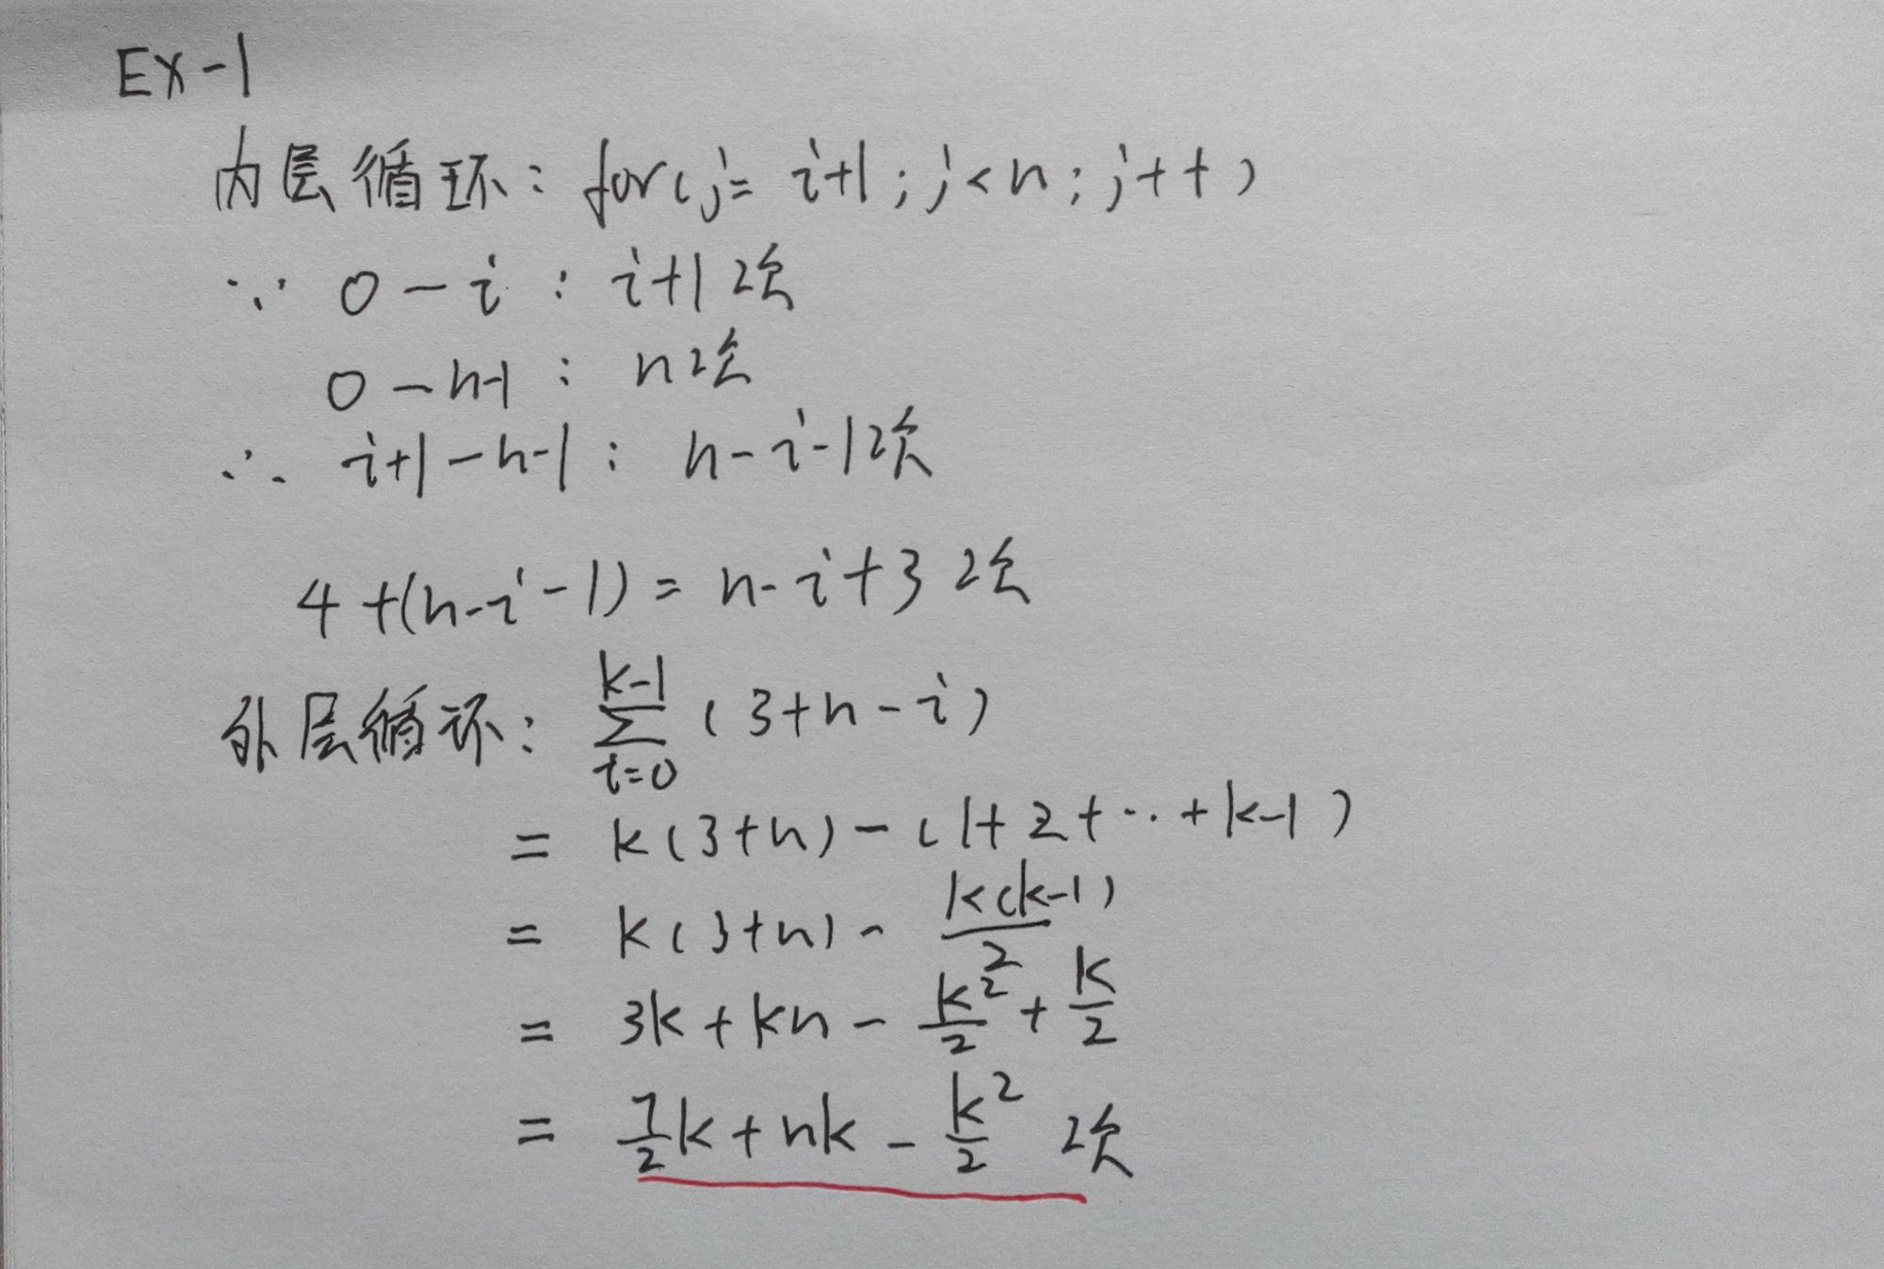

Slide 15
Ex-2
Find the computational complexity for the following four loops:
c. for (cnt3=0, i =1; i<=n; i*=2)
for (j=1; j<=n; j++)
cnt3++;
d. for (cnt4=0, i=1; i<=n; i*=2)
for (j=1; j<=i; j++)
cnt4++;

Slide 16
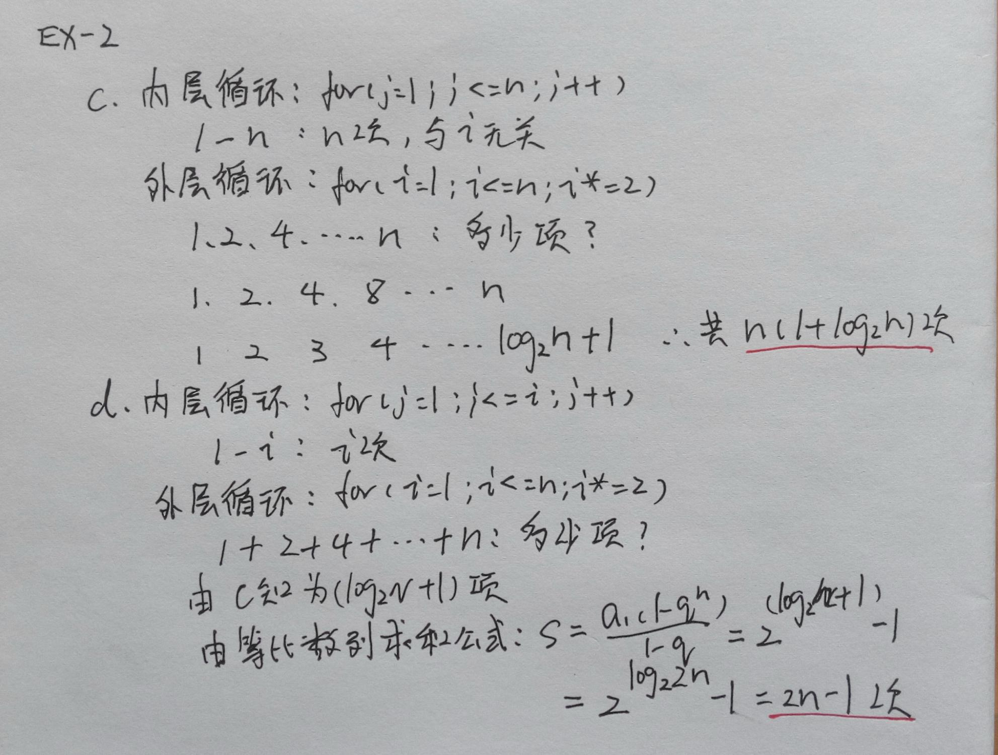

Slide 17
Ex-3
For each of the following two program fragments: Give an analysis of the running time(Big-Oh will do)
sum = 0;
for( i = 0; i < n; i++ )
for( j = 0; j <i*i; j++ )
for( k = 0; k <j; k++ )
sum++;
sum = 0;
for( i = 1; i < n; i++ )
for( j = 0; j < i*i; j++ )
if( j % i == 0 )
for( k = 0; k < j; k++ )
sum++;

Slide 18
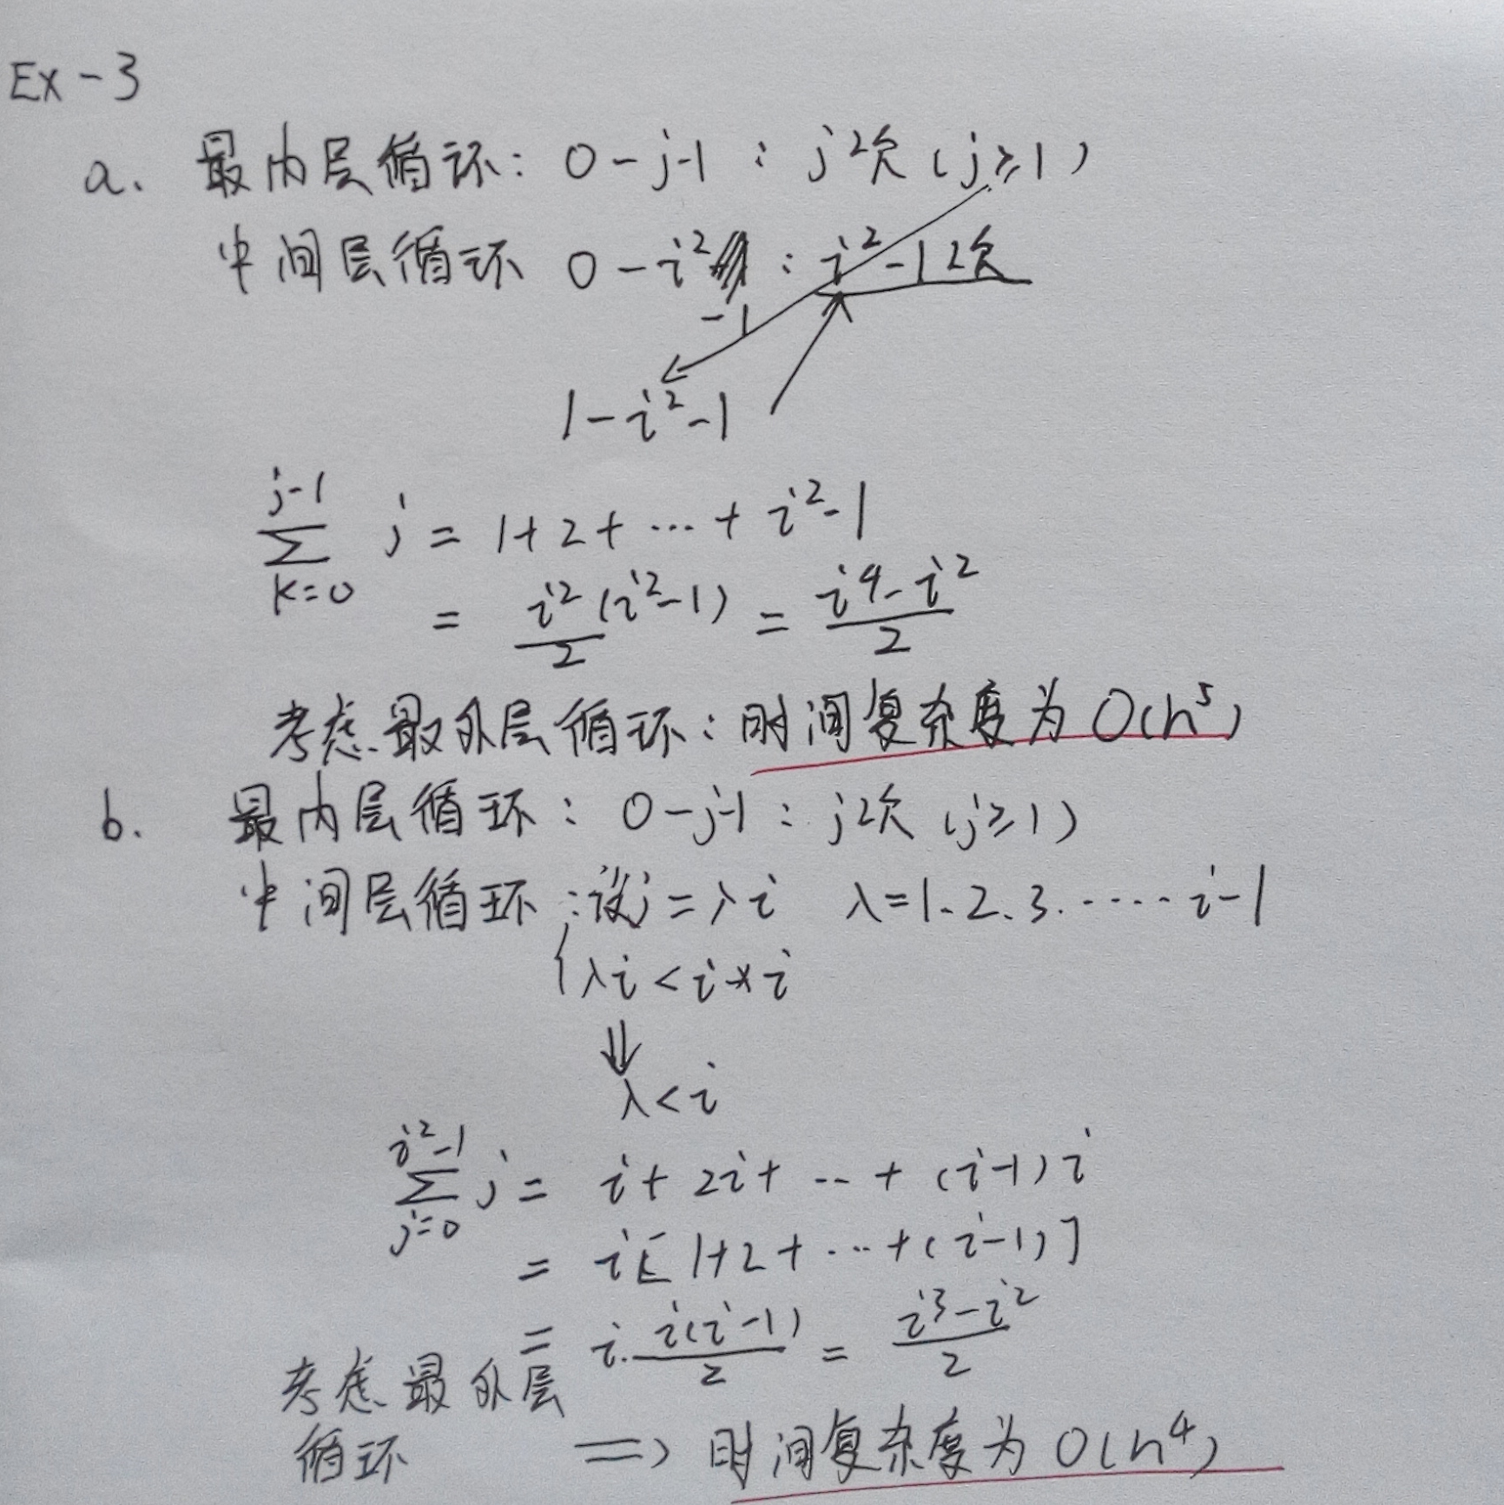

Slide 19
Ex-4
设n为正整数，分析下列各程序段中加下划线的语句的执行次数。
1) for (int i = 1; i <= n; i++)
for (int j = 1; j<=n; j++)
{ c[i][j] = 0.0;
for ( int k = 1; k <= n; k++)
c[i][j] = c[i][j]+a[i][k]*b[k][j]; //n*n*n次
}
2) x = 0; y = 0;
for (int i = 1; i <= n; i++)
for (int j = 1; j <= i; j++)
for (int k = 1; k <= j; k++)
x = x+y;
3) int x = 91; int y = 100;
while(y>0)
{ if(x>100) { x -= 10; y--; } // (1) //100次
else x++; // (2) //1000次
}

Slide 20
